Slide 1
False Discovery Rate Controlled Robust Variable Selection Under Cellwise Contamination
Xiaoya Sun, Houying Zhu, Garth Tarr, Samuel Muller
28 Nov 2025 Biometrics in the Bush Capital

Slide 2
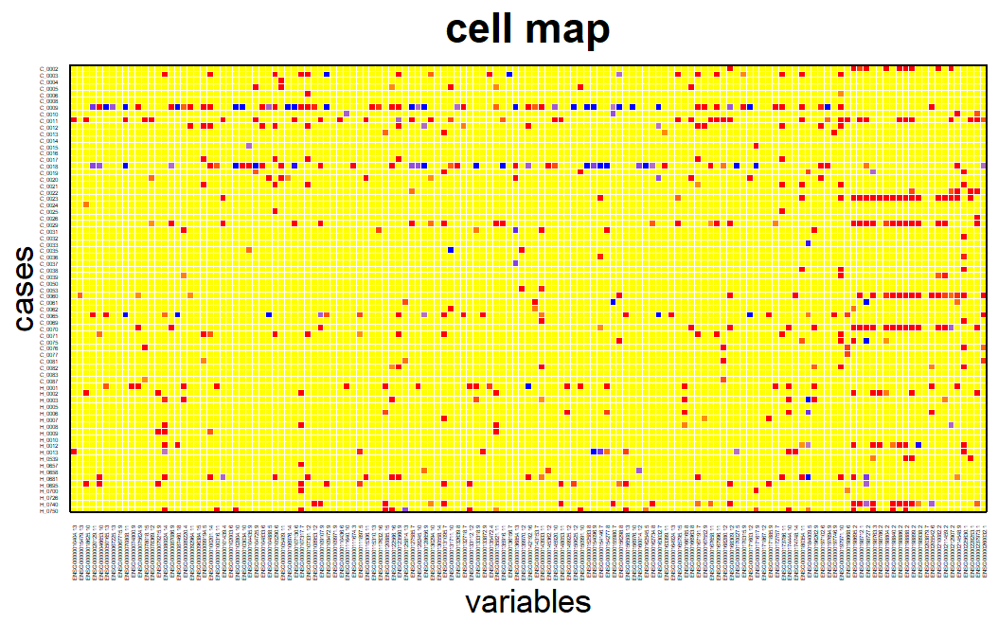
False Discovery Rate Controlled Robust Variable Selection Under Cellwise Contamination
Original Sample
GR Transformed Sample
GR-ALasso Optimization
Knockoff Counterpart
GR Transformed Knockoff
GR-ALasso Optimization
GRALF
Two Statistics Competing
Cellwise Outlier
FDR Control & Variable Selection
• How do variable selection methods handle high-rate cellwise contamination effectively?
• Can robust variable selection methods control error rates?
GRALF, a Gaussian-Ranked Adaptive Lasso method with False discovery rate (FDR) control

Slide 3
Background
Cellwise Outlier
Cellwise outlier*:
Contamination in each variable is independent from the other variables
Contamination*:
Abnormal noise: large-scale fluctuations that arise from data contamination, uneven data quality, mixed populations, gross errors, etc.
* Alqallaf, Fatemah, et al. "Propagation of outliers in multivariate data." The Annals of Statistics (2009): 311-331.

Slide 4
Background
Variable Selection with Cellwise Contamination
How do variable selection methods handle cellwise outliers?
Huber-Lasso
MM-Lasso
Adaptive Robust Lasso
Weighted Lasso for Cellwise Outliers
Robust Penalized Regression with Cellwise Weights
…
…

Slide 5
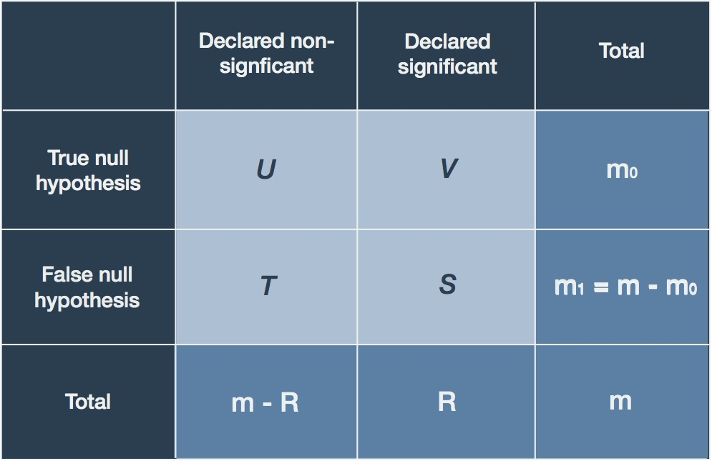
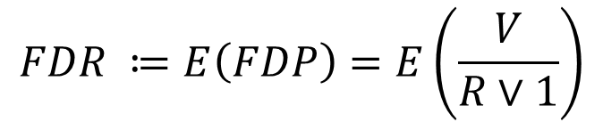
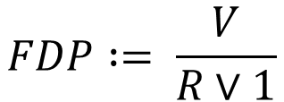
Background
False Discovery Rate (FDR) Control
False Discovery Proportion (FDP):
$$FDP := \frac{V}{R∨1}$$
False Discovery Rate (FDR):
$$FDR ≔E\left(FDP\right)=E\left(\frac{V}{R∨1}\right)$$
Expected proportion of false positives out of all rejected null hypotheses (discoveries)

Slide 6
Background
FDR Controlled Variable Selection with Cellwise Outliers
• Can robust variable selection methods control error rates?
Cellwise Outlier
GR-ALasso
GRALF
Linear regression model variable selection with cellwise outlier
the Gaussian-Ranked adaptive Lasso variable selection method
the Gaussian-Ranked adaptive Lasso variable selection method with FDR control

Slide 7
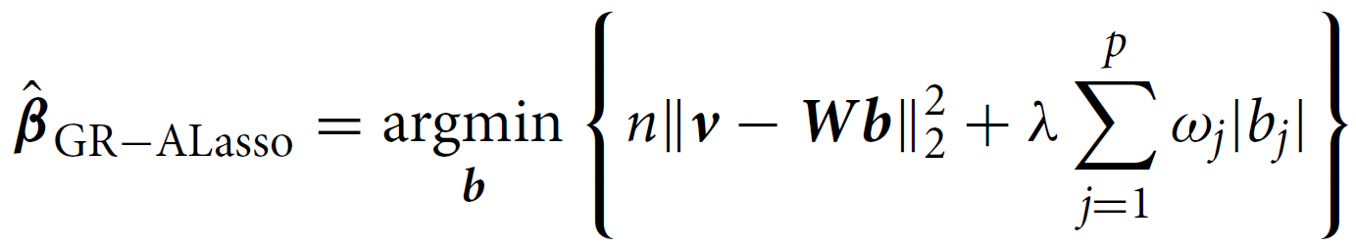
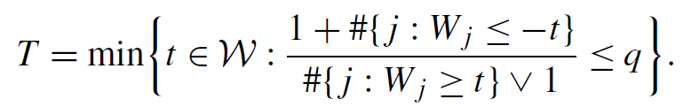
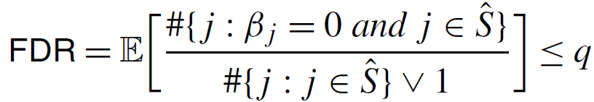
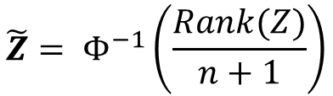
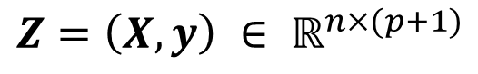
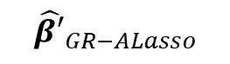
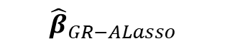
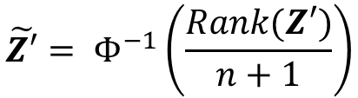
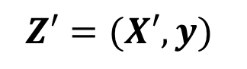
Method - GRALF
GRALF overview
$$Z=\left(X,y\right) ∈ ℝ^{n×(p+1)}$$
Knockoff counterpart
$$Z′=(X′,y)$$
GR transformed sample
GR transformed knockoff counterpart
$$\tilde{Z}= Φ^{−1}\left(\frac{Rank(Z)}{n+1}\right)$$
$$\tilde{Z′}= Φ^{−1}\left(\frac{Rank(Z′)}{n+1}\right)$$
Optimization
Optimization
$${\hat{β}}_{GR−ALasso}$$
$${\hat{β′}}_{GR−ALasso}$$
$W_{j}=sgn⁡({\hat{β}}_{j,GR−ALasso} −{\hat{β′}}_{j,GR−ALasso})$ * |${\hat{β}}_{j,GR−ALasso}$|
Variable selection
FDR control

Slide 8
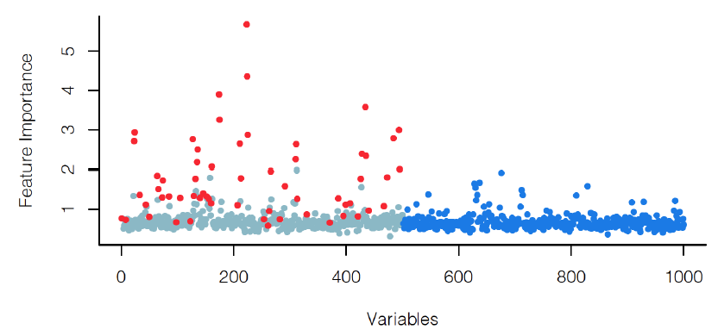
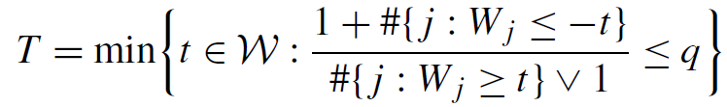
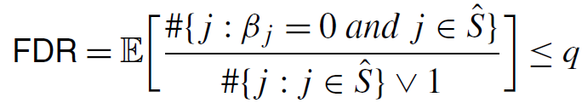
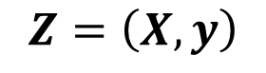
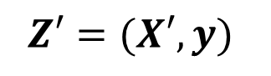
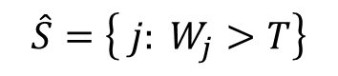
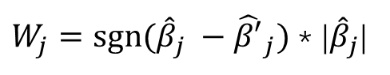
Method
Knockoff for FDR control
$$Z=\left(X,y\right)$$
counterpart
$$Z′=(X′,y)$$
Symmetric statistics:
$W_{j}=sgn⁡({\hat{β}}_{j} −{\hat{β′}}_{j})$ * |${\hat{β}}_{j}$|
Variable selection:
$$\hat{S}=\left\{ j: W_{j}>T\right\}$$
FDR control:
Original data with signals
Fake data (all irrelevant)
8

Slide 9
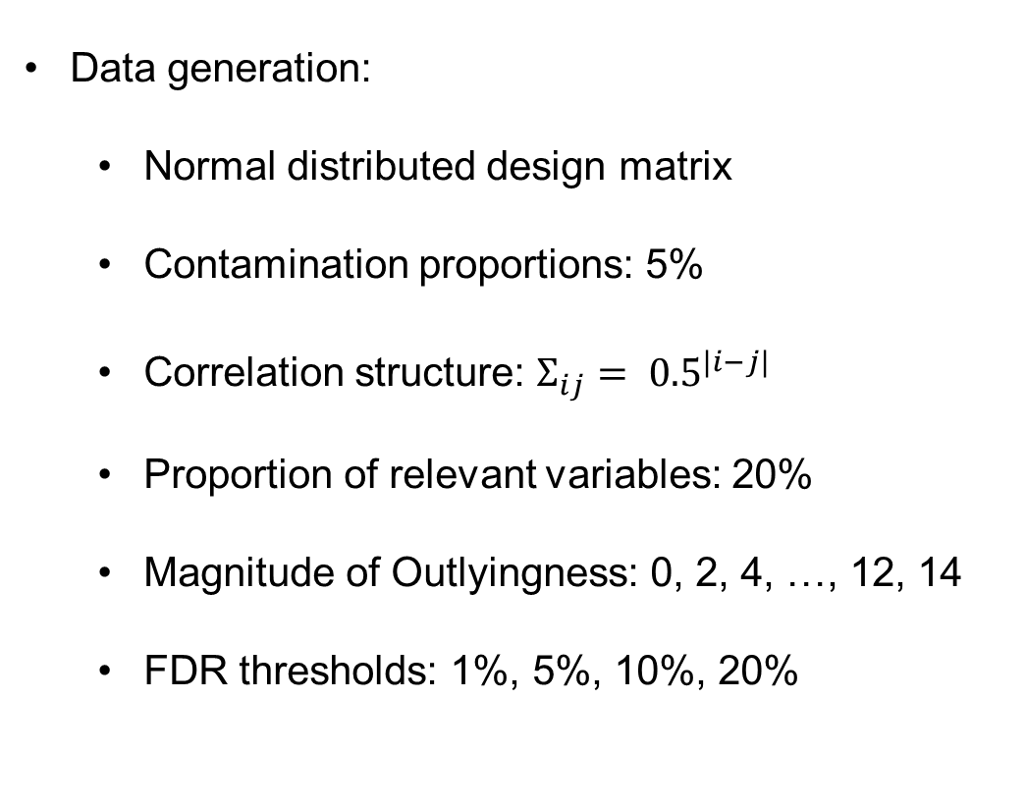
Simulation
Data Generation and Performance Metrics
Data generation:
Normal distributed design matrix
Contamination proportions: 5%
Correlation structure: $Σ_{ij}= {0.5}^{|i−j|}$
Proportion of relevant variables: 20%
Magnitude of Outlyingness: 0, 2, 4, …, 12, 14
FDR thresholds: 1%, 5%, 10%, 20%
Performance Metrics:
Empirical FDR
Power
Matthew’s Correlation Coefficient (MCC)

Slide 10
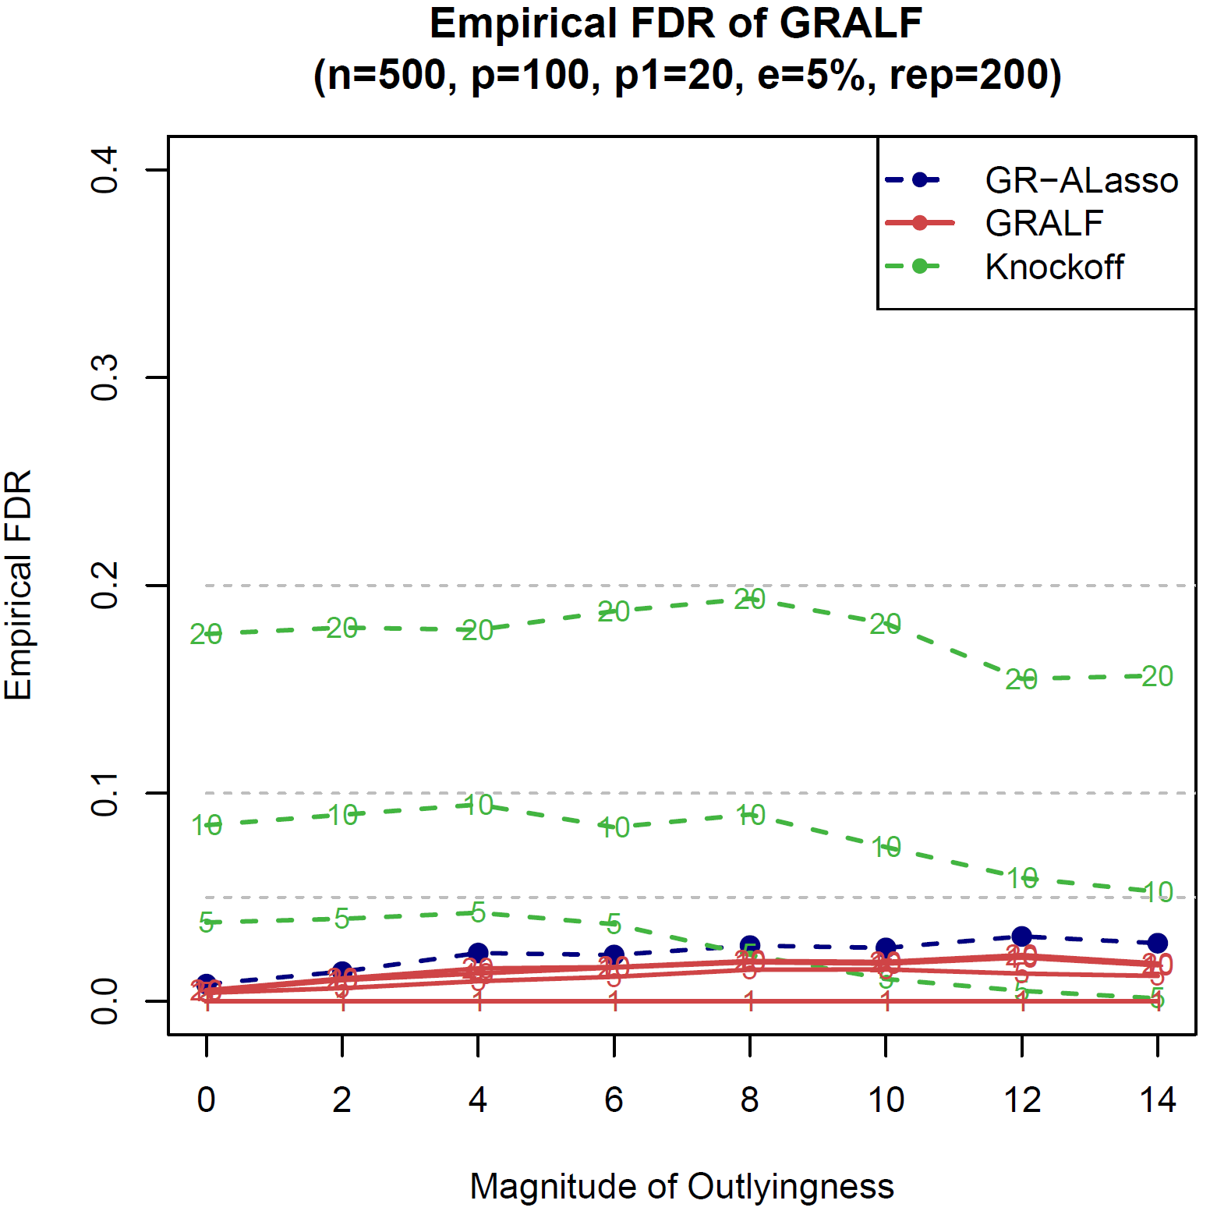
Simulation Results ($n>p$)
10

Slide 11
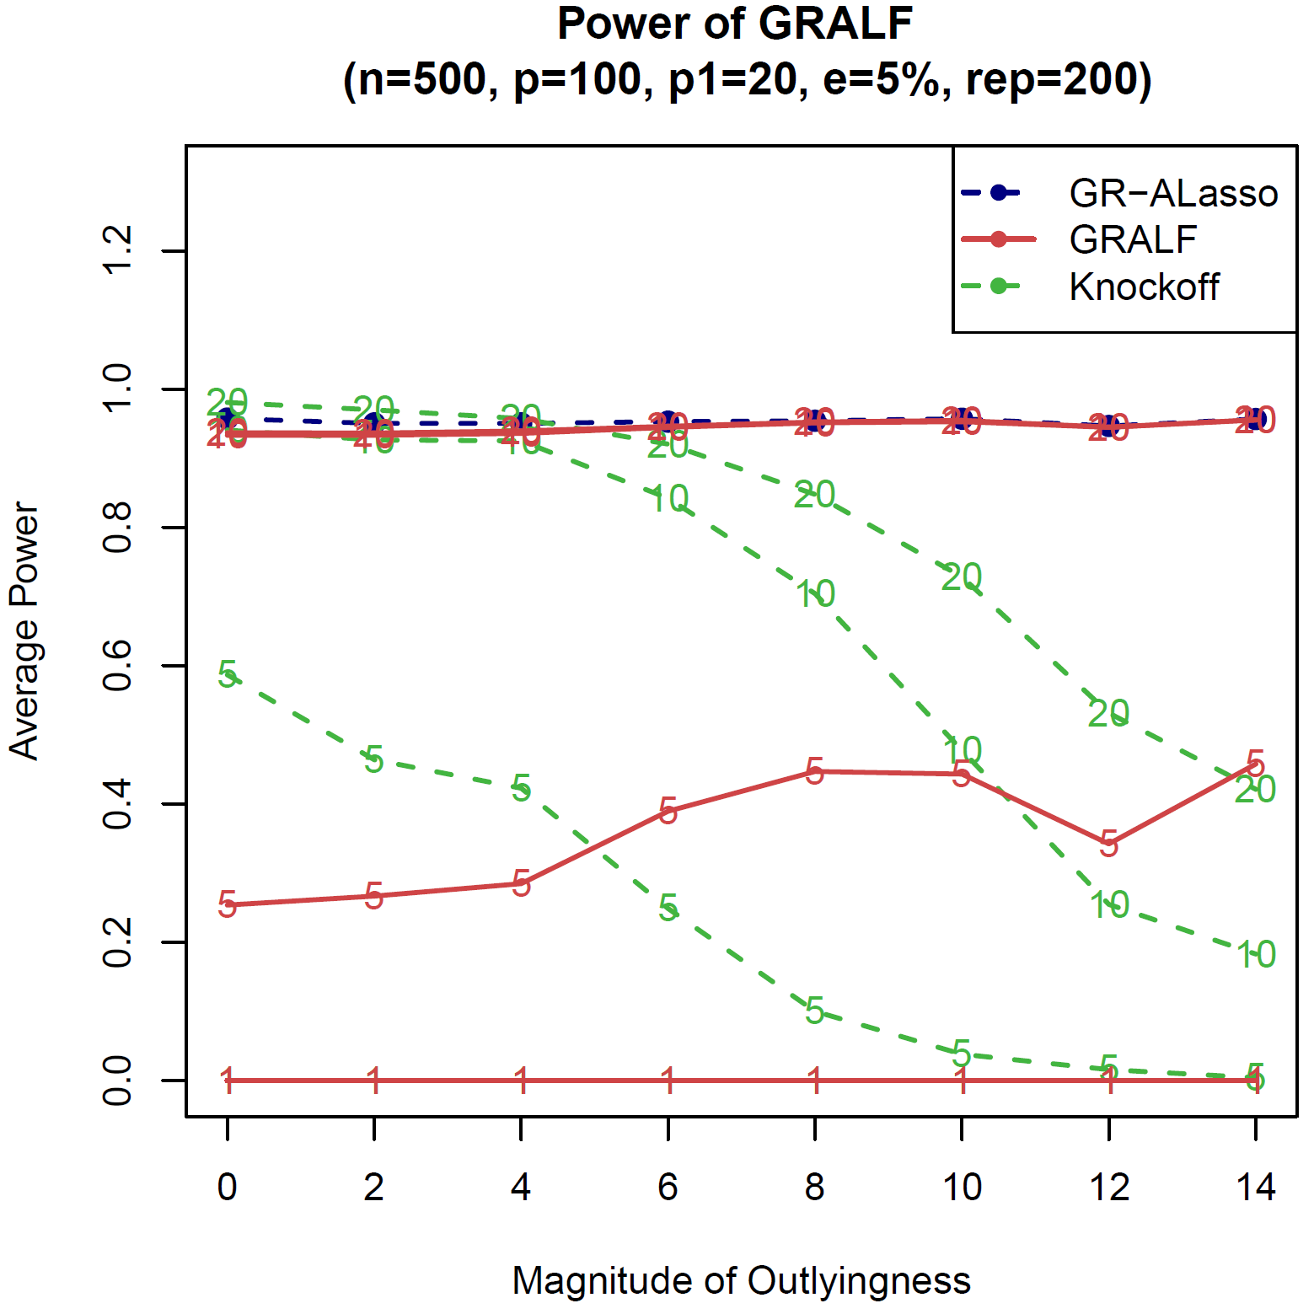
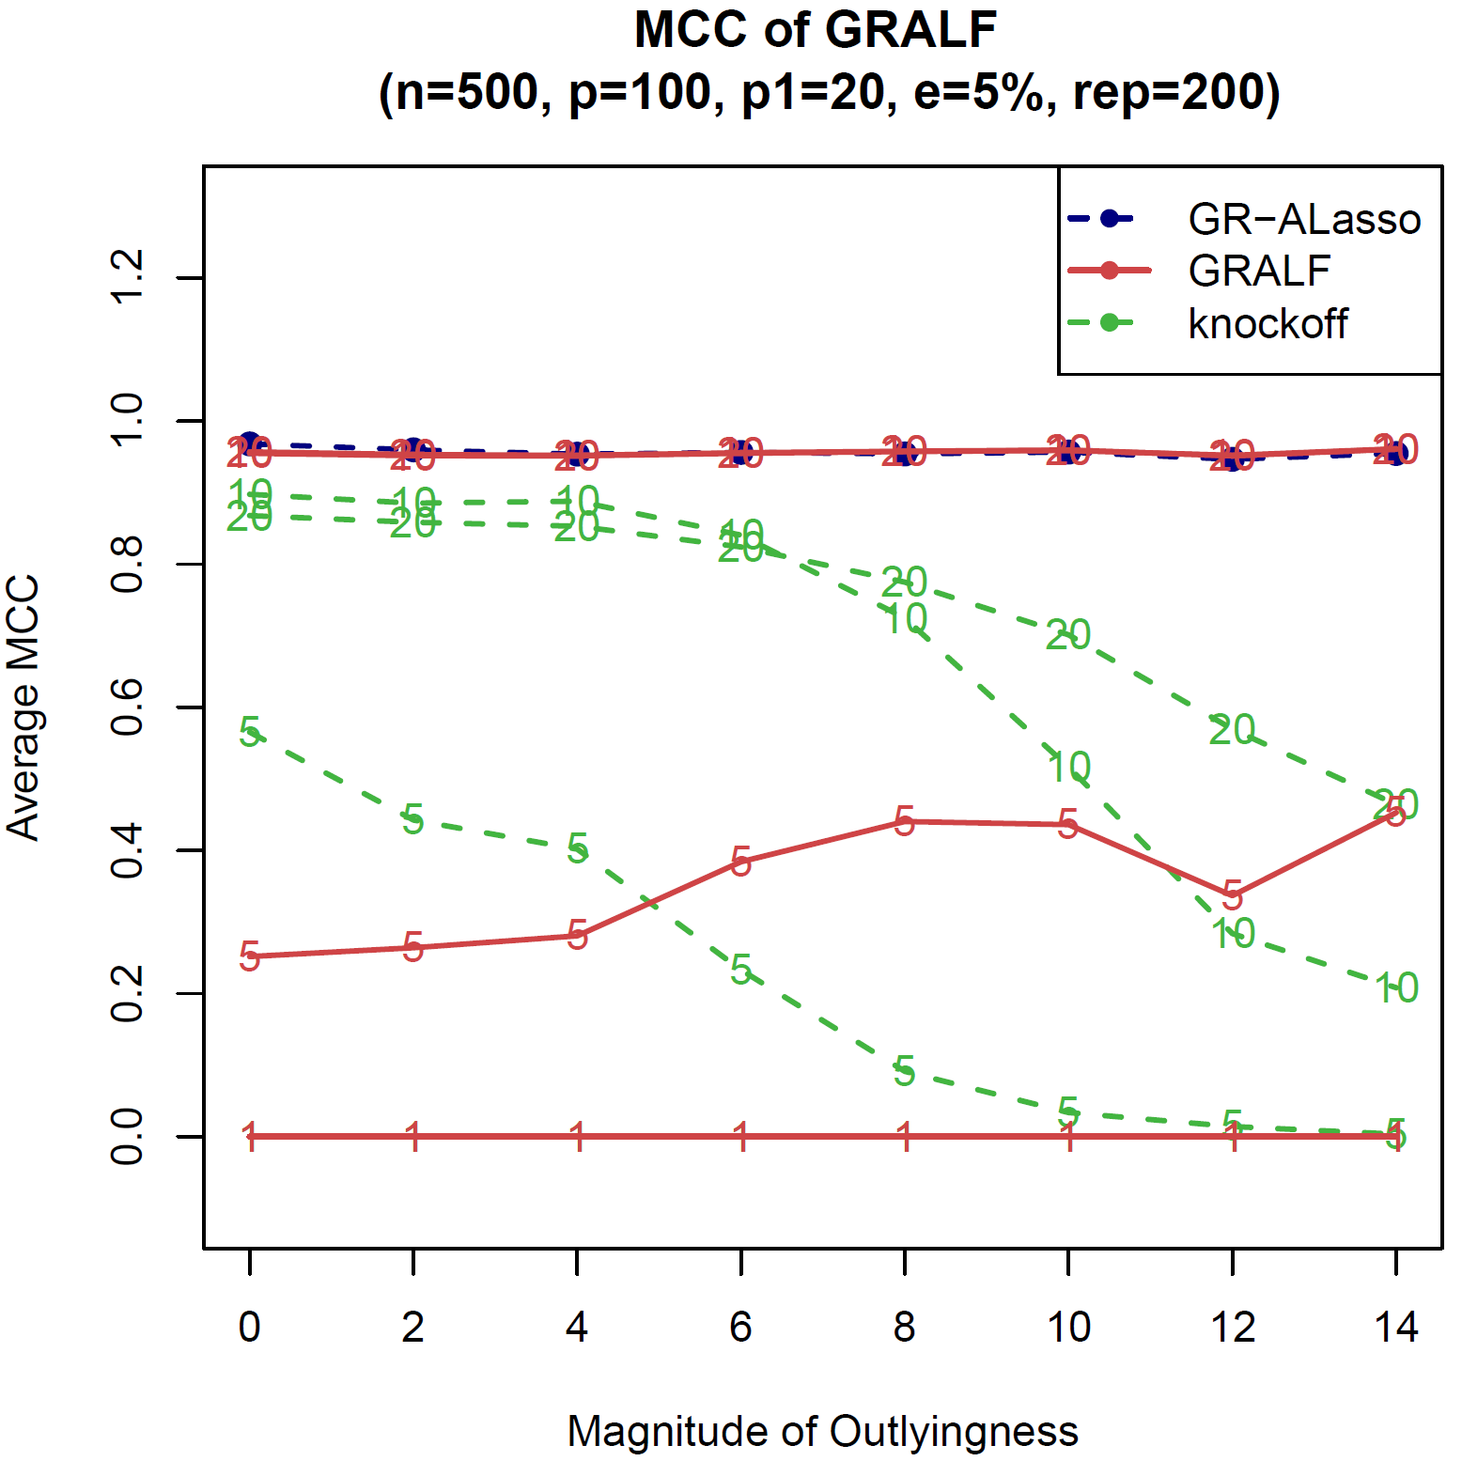
Simulation Results ($n>p$)
Results of n>p setting:
11

Slide 12
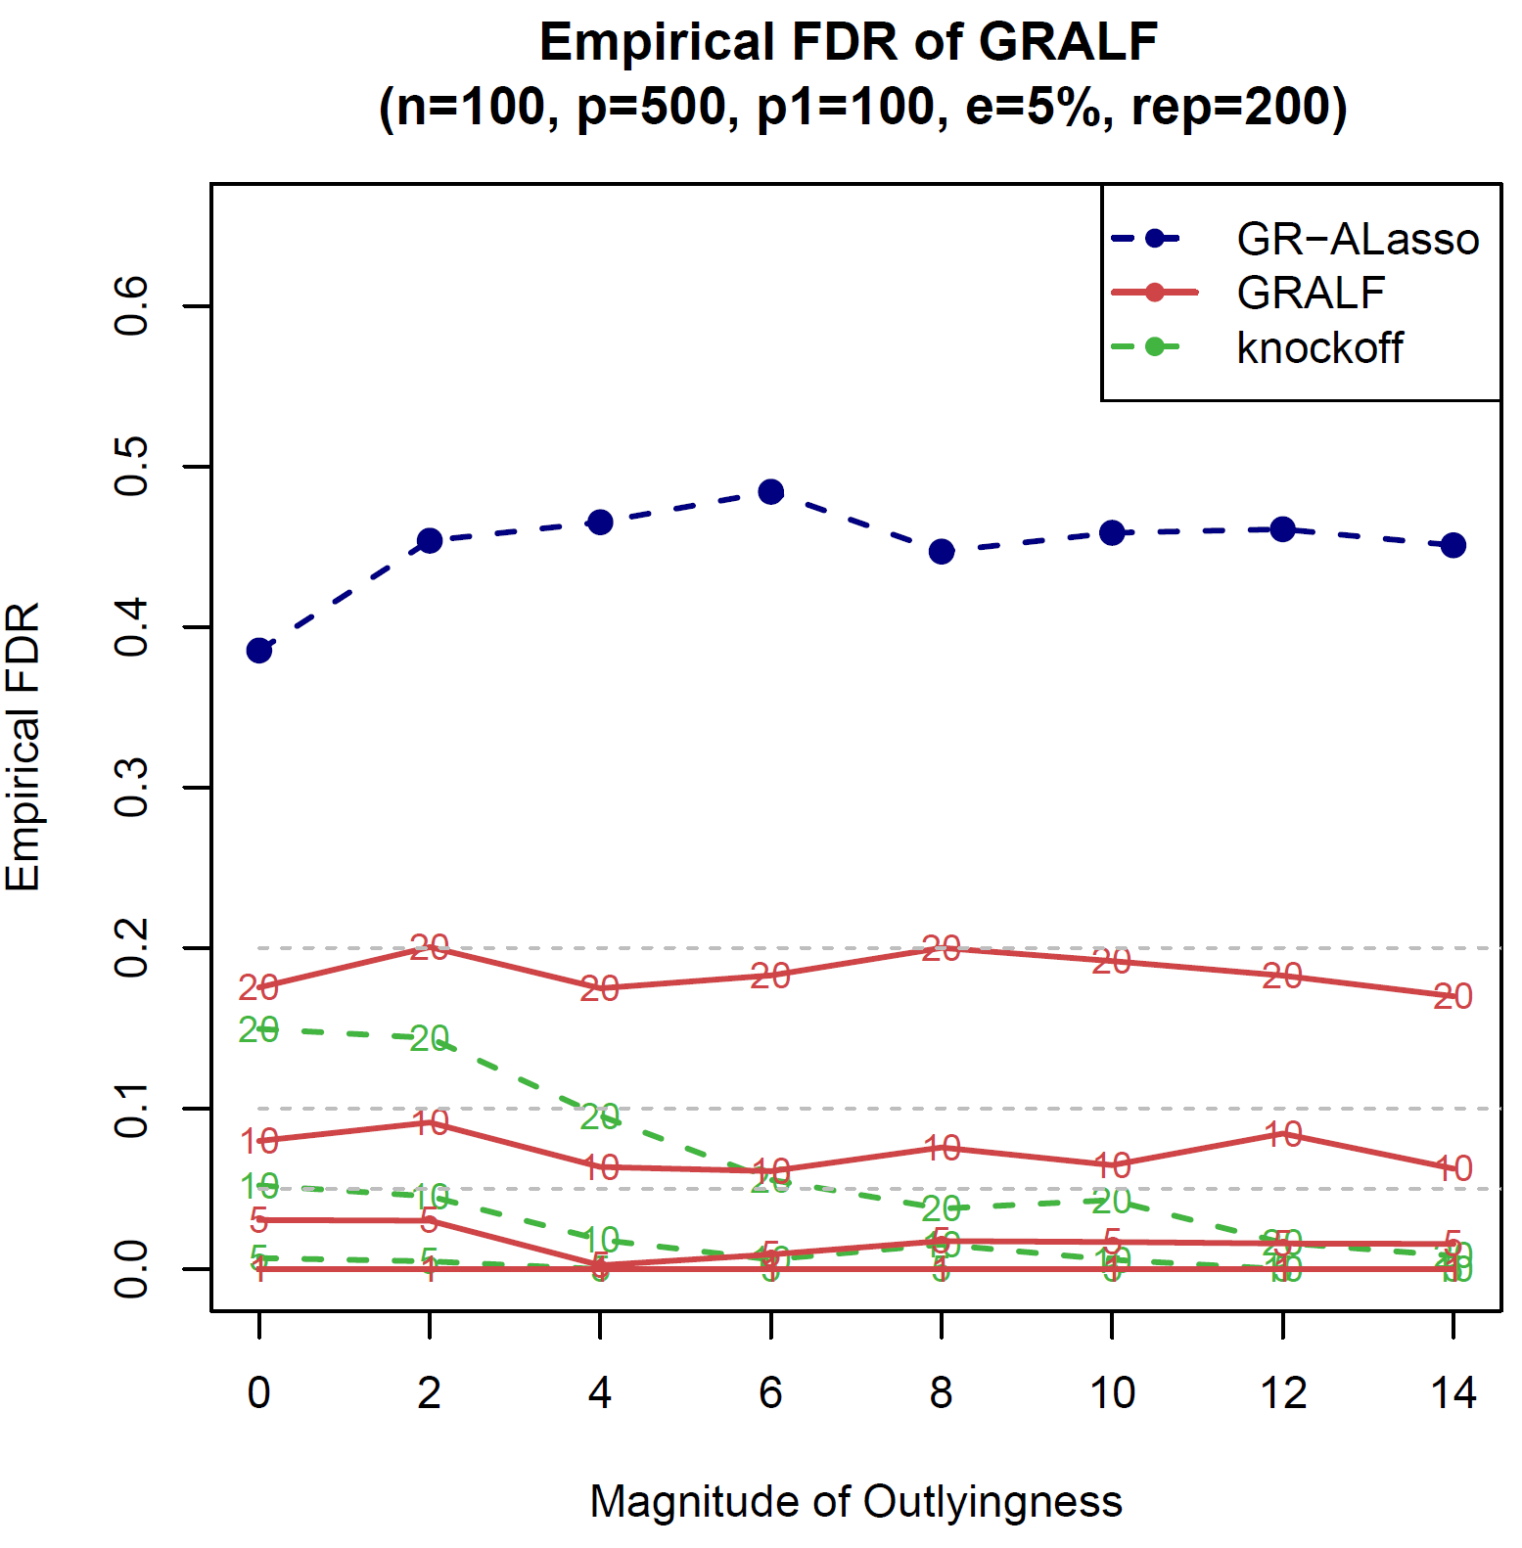
Simulation Results ($p>n$)
12

Slide 13
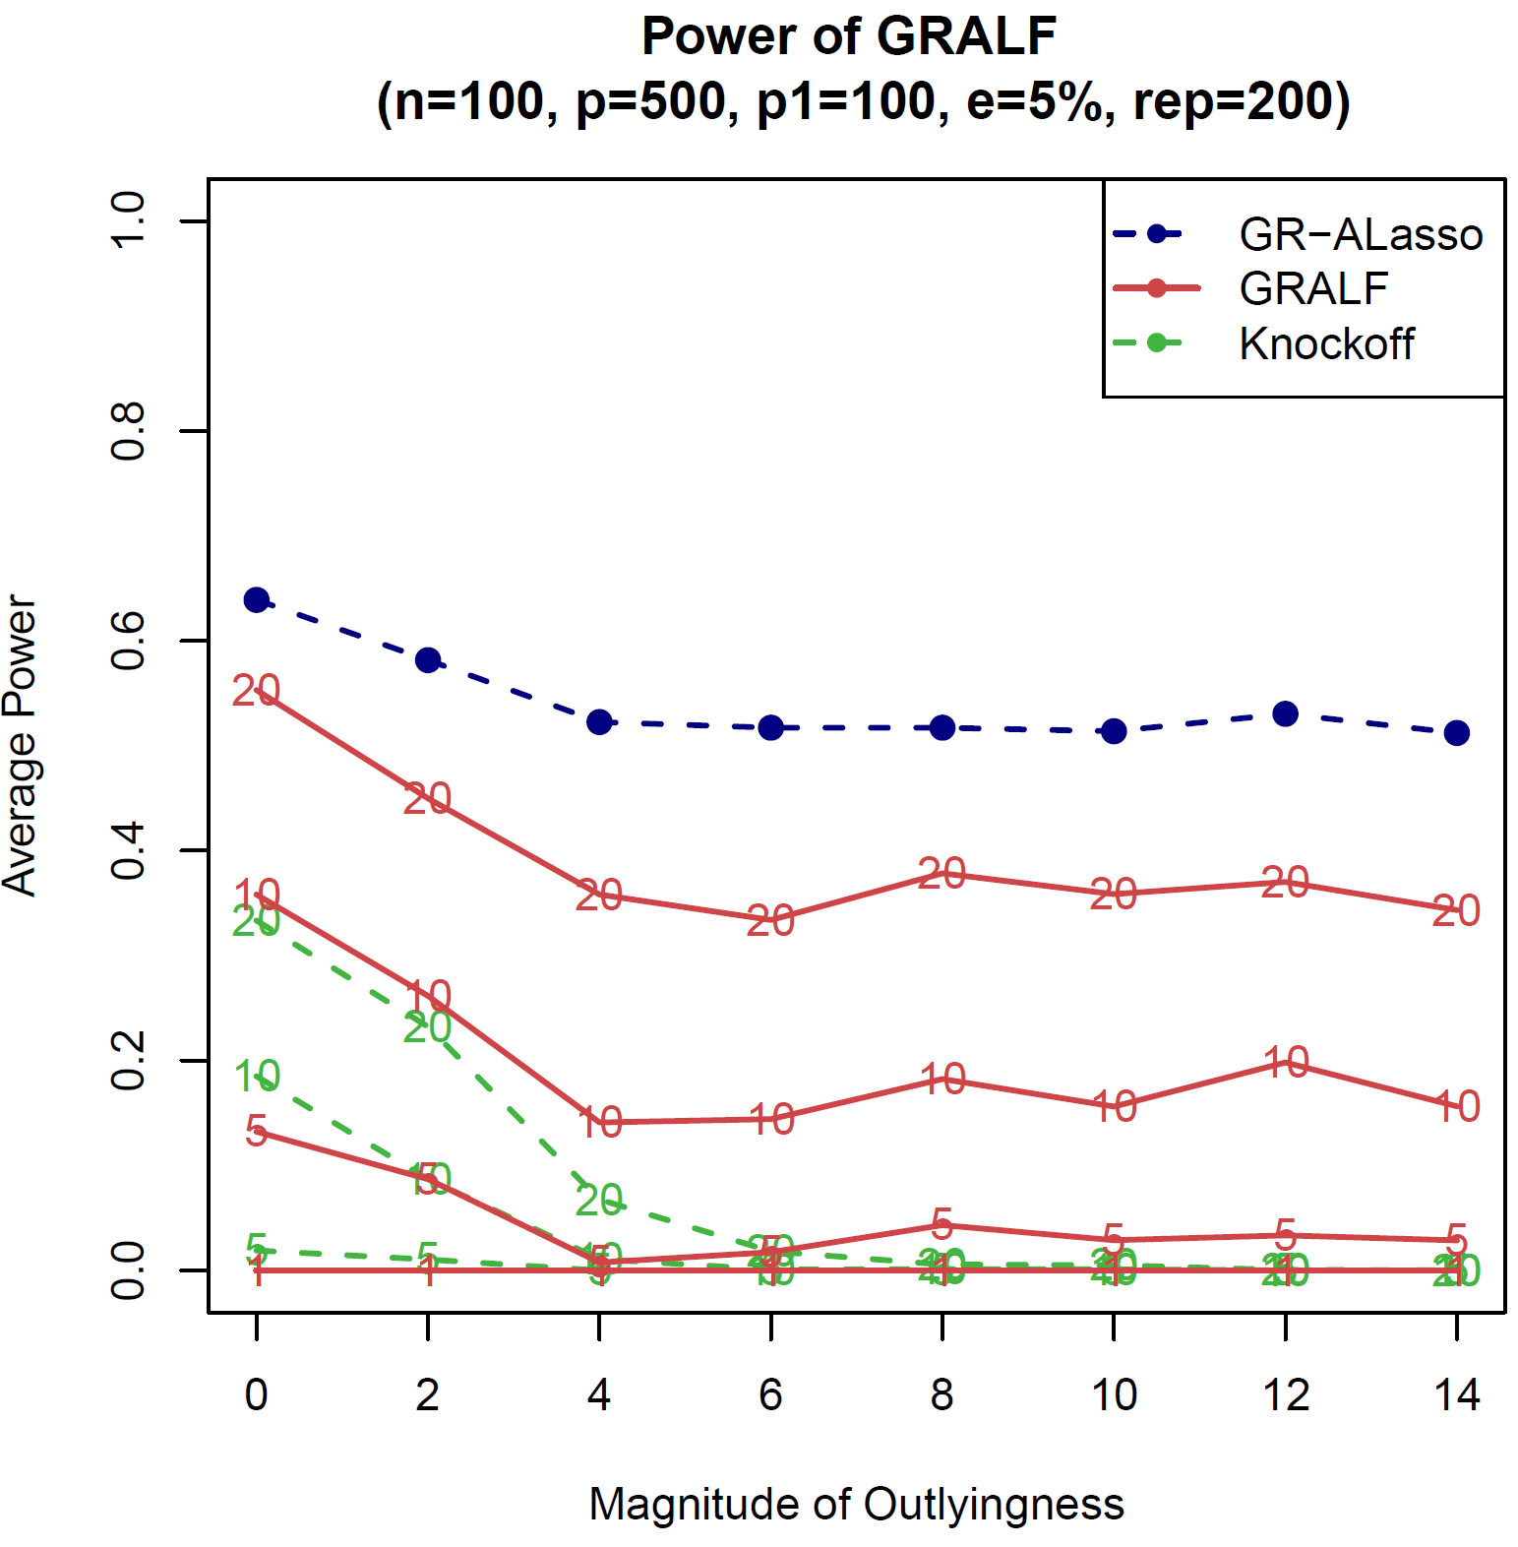
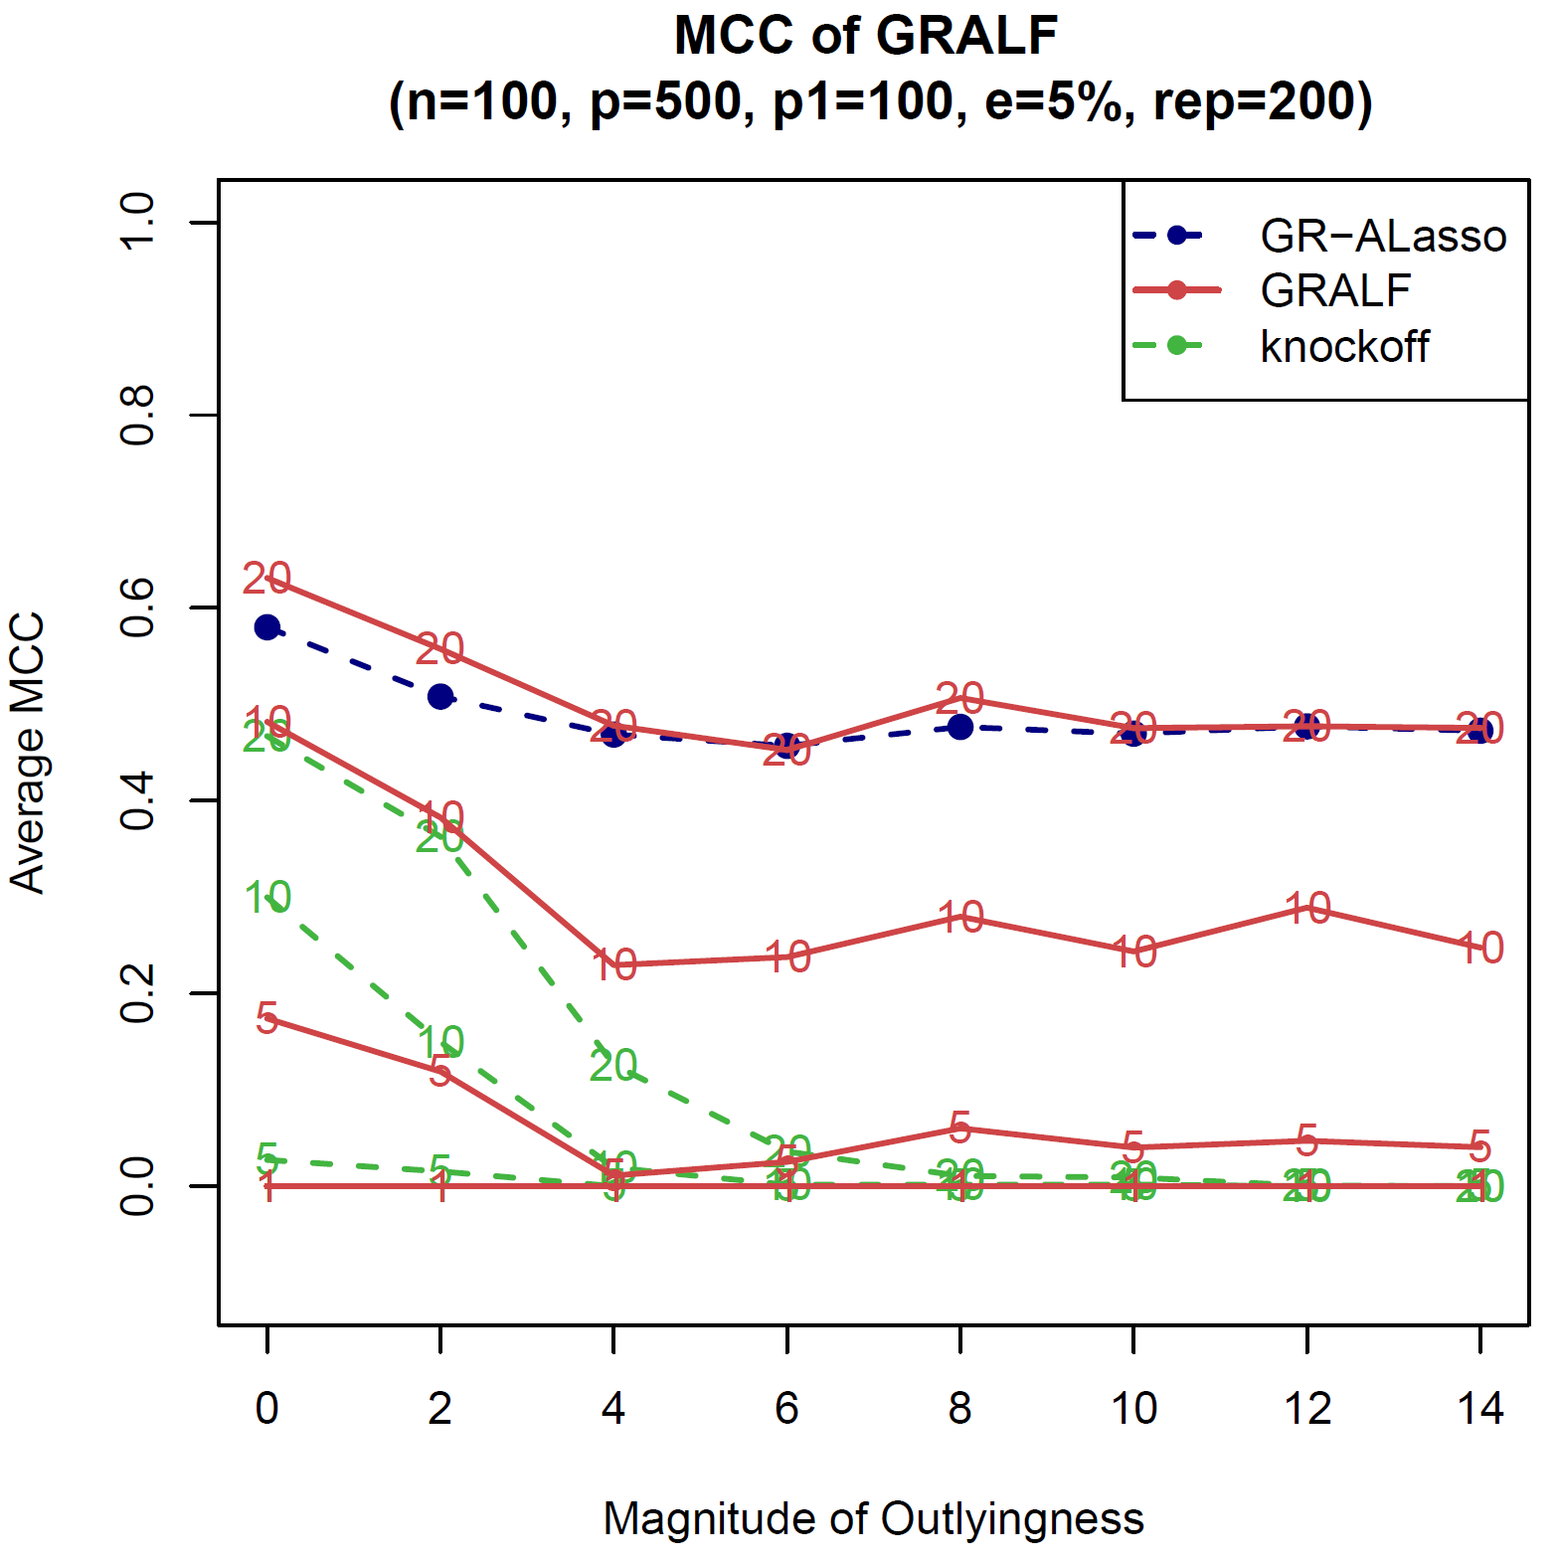
Simulation Results ($p>n$)
13

Slide 14
Summary
GRALF: Gaussian-Ranked Adaptive Lasso method with FDR control
Variable selection under outlier contamination with error rate control
Integration of GR-ALasso and Knockoff
Future Work
Optimization step could be generalized
FDR control part could be improved for high-dimensional data

Slide 15



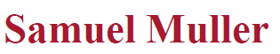
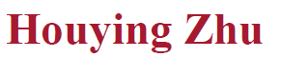





Summary
Statistical Modelling Group
Ibrahim Joudah
Mahdi Nouraie
Arjun Sekhar
Xiaoya Sun
xiaoya.sun@mq.edu.au

